Slide 1

In God we trust. All others must bring data.
Theory without data is myth: data without theory is madness.
That which you mistake for madness is but an overacuteness of the senses
Notes:
William Edwards Deming (Statistician, 1900-1993)
Phil Zuckerman (Sociologist, 1969- )
Edgar Allan Poe (Author, 1809-1849)

Slide 2
Crime analysis in San Francisco
By Jose and Pablo
https://www.youtube.com/watch?v=N8Kh3QOCEsA

Slide 3
Crime analysis in Vancouver
By Misha and Philippe
https://www.youtube.com/watch?v=QcB1YcMFyMI

Slide 4
UK traffic accidents
By Anh and Wouter
https://www.youtube.com/watch?v=kdDxYdHq4bM
https://github.com/wouterleeftink/travel-madness

Slide 5

Vehicle collisions in NYC
By Nordine and Simon
https://www.youtube.com/watch?v=XKY3nBiIuN0
https://github.com/swengeler/AounisAwefulAccidentsFeatWengelersWoefulWreckages

Slide 6
Air Pollution in USA
By Aleksandra and Lukas
https://youtu.be/W1x3KA9zCOk

Slide 7
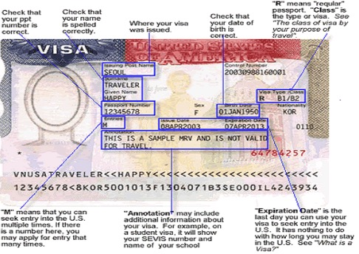
US Visa Application statistics
By Jade and Kamil
https://drive.google.com/file/d/1UW5VzxpgnQ8ynIf6KskpMxp_D7_md1o2/view

Slide 8
Pima Indians Diabetes
By Eric and Max
https://www.youtube.com/watch?v=etjyzgokN5Y

Slide 9

Advanced NBA analytics
By Dorian and Presian
https://youtu.be/XHsbQNyn44c
https://github.com/dorianb96/data-madness

Slide 10
Olympic Games Medals
By Jonty and Megan
https://www.youtube.com/watch?v=O_TBhQE18Kk

Slide 11

airbnb statistics
By Carla and Esther
https://www.youtube.com/watch?v=e9R91p_sWqk

Slide 12
UK e-commerce analysis
By Leonardo and Nicola
https://youtu.be/nw99g_YJvvk
https://github.com/nicolagheza/Data-Madness-Ecommerce

Slide 13
Predicting fuel prices in the UK
By Eric
https://www.youtube.com/watch?v=u7uylM19VTY

Slide 14
To Brexit or not to Brexit?
By Aleksas and Callum
https://www.youtube.com/watch?v=6rwT90aM7Gg

Slide 15
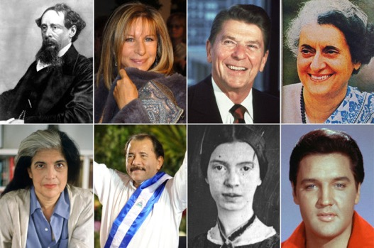
Exploring History’s Famous People
By Alexander and Raffaele
https://www.youtube.com/watch?v=vfMunvtmQu4

Slide 16
Analyzing CITES data
By Bianca and Nik
https://www.youtube.com/watch?v=jpwDHPU5WIk
https://github.com/nikvaessen/da-madness

Slide 17

Portuguese students performance
By Adam and Leroy
https://www.youtube.com/watch?v=G0uQnirDiZw

Slide 18
Measuring Morality
By Henry, Martin, Matteo
https://github.com/HerraHiekka/DataMadness

Slide 19

Bypassing Morality
By Markus and Mahyar
https://www.youtube.com/watch?v=4wWrvu8-xJU

Slide 20
Wine reviews
By Alexis and Raffaele
https://www.youtube.com/watch?v=3JseodovUJg
https://youtu.be/gWKIpVLyTZ8 (Extended version)

Slide 21

YouTube trending videos
By Jordy and Sidney
https://www.youtube.com/watch?v=UWxubi8tkbw

Slide 22
MovieLens analysis
By Jeroen and Xavier
https://github.com/Lobscob/Data-Madness

Slide 23

RuPaul’s Data Race
By Ana and Evelina
https://vimeo.com/262053828

Slide 24
Game of Thrones
By Ajki and Iulia
https://www.youtube.com/watch?v=kx7sUaNLqrw
https://github.com/iuliaferoli/data_madness

Slide 25

Which is the top Pokemon?
By Anik and Dominika
https://gallery.moovly.com/video/f7bad196-2ff2-471d-be24-4b52815282ca

Slide 26
Music Madness
By Assad, Casper and Tonio
https://youtu.be/pjzG-eFzCug
https://www.powtoon.com/c/bC7GP75SZQR/1/m (Full HD)
https://github.com/weidler/music-madness

